Slide 1
Lesson 7
Working with Composite Data Types

Slide 2
Objective
After completing this lesson, you should be able to do the following:
  Describe PL/SQL collections and records
  Create user-defined PL/SQL records
  Create a PL/SQL record with the %ROWTYPE attribute
  Create associative arrays
    INDEX BY table
    INDEX BY table of records

Slide 3
Lesson Agenda
  Understanding composite data types
  Using PL/SQL records
    Manipulating data with PL/SQL records
    Advantages of the %ROWTYPE attribute
  Using PL/SQL collections
    Examining associative arrays
    Introducing nested tables
    Introducing VARRAY

Slide 4
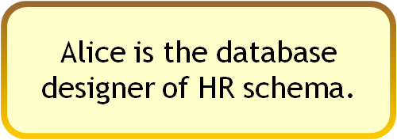






Composite Data Types
Alice wonders!
New Employees’ Details
Is there a way to add more than one contact number in the same table?
Name
Date of Birth
Contact
Address
Designation
Department
Salary
Is there a way to group an employee’s address as a single column?

Slide 5

Composite Data Types
PL/SQL records
Associative arrays
Composite data types
Collections
Nested Tables
VARRAYs

Slide 6
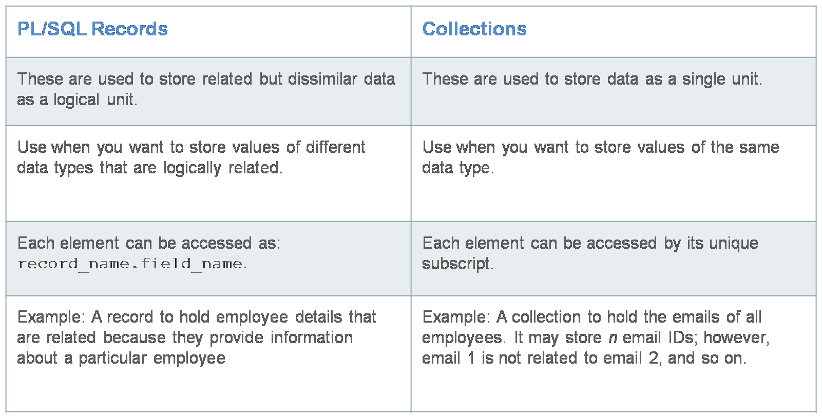
PL/SQL Records Versus Collections

Slide 7
Agenda
  Understanding composite data types
  Using PL/SQL records
    Manipulating data with PL/SQL records
    Advantages of the %ROWTYPE attribute
  Using PL/SQL collections
    Examining associative arrays
    Introducing nested tables
    Introducing VARRAY

Slide 8




PL/SQL Records
Employee promotions!
Update the job_id of each employee.
Add data to the job_history table to reflect promotion.
Modify the salary of the employee.

Slide 9



Creating a PL/SQL Record
Syntax:
TYPE type_name IS RECORD
(field_declaration[, field_declaration]…);
1
2
identifier type_name;
field_declaration:
field_name {field_type | variable%TYPE
| table.column%TYPE | table%ROWTYPE}
[[NOT NULL] {:= | DEFAULT} expr]

Slide 10


Creating a PL/SQL Record: Example
DECLARE
TYPE t_rec IS RECORD
(
v_first_name employees.first_name%type,
v_sal number(8),
v_hire_date employees.hire_date%type,
);
v_myrec t_rec;
BEGIN
SELECT first_name,salary, hire_date INTO v_myrec
FROM employees WHERE employee_id = 100;
DBMS_OUTPUT.PUT_LINE('First Name:
'||v_myrec.v_first_name ||'Salary:
'||v_myrec.v_sal ||'Hire Date:
'|| v_myrec.v_hire_date);
END;

Slide 11
PL/SQL Record Structure
Field declarations:
Field1 (data type)
Field2 (data type)
Field3 (data type)
Example:
Field1 (data type)
Field2 (data type)
Field3 (data type)
employee_id number(6)
last_name varchar2(25)
job_id varchar2(10)
100 King AD_PRES

Slide 12
%ROWTYPE Attribute
  Declare a variable according to a collection of columns in a database table or view.
  Fields in the record take their names and data types from the columns of the table or view.
Prefix %ROWTYPE with the database table or view.
Syntax:
DECLARE
identifier reference%ROWTYPE;
Example:
DECLARE
employees employees%ROWTYPE;

Slide 13


Creating a PL/SQL Record: Example
DECLARE
TYPE t_rec IS RECORD
(v_sal number(8),
v_minsal number(8) default 1000,
v_hire_date employees.hire_date%type,
v_rec1 employees%rowtype);
v_myrec t_rec;
BEGIN
v_myrec.v_sal := v_myrec.v_minsal + 500;
v_myrec.v_hire_date := sysdate;
SELECT * INTO v_myrec.v_rec1
FROM employees WHERE employee_id = 100;
DBMS_OUTPUT.PUT_LINE(v_myrec.v_rec1.last_name ||' '||
v_myrec.v_hire_date ||' '|| v_myrec.v_sal);
END;

Slide 14
Advantages of Using the %ROWTYPE Attribute
  The number and data types of the underlying database columns need not be
  known—and, in fact, might change at run time.
  The %ROWTYPE attribute is useful when you want to retrieve a row with:
    The SELECT * statement
    The row-level INSERT and UPDATE statements

Slide 15

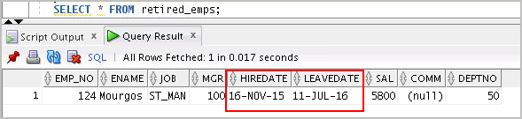
Another %ROWTYPE Attribute: Example
DECLARE
v_employee_number number:= 124;
v_emp_rec employees%ROWTYPE;
BEGIN
SELECT * INTO v_emp_rec FROM employees
WHERE employee_id = v_employee_number;
INSERT INTO retired_emps(empno, ename, job, mgr,
hiredate, leavedate, sal, comm, deptno)
VALUES (v_emp_rec.employee_id, v_emp_rec.last_name,
v_emp_rec.job_id, v_emp_rec.manager_id,
v_emp_rec.hire_date, SYSDATE,
v_emp_rec.salary, v_emp_rec.commission_pct,
v_emp_rec.department_id);
END;
/

Slide 16

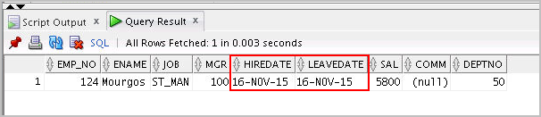
Inserting a Record by Using %ROWTYPE
...
DECLARE
v_employee_number number:= 124;
v_emp_rec retired_emps%ROWTYPE;
BEGIN
SELECT employee_id, last_name, job_id, manager_id,
hire_date, hire_date, salary, commission_pct,
department_id INTO v_emp_rec FROM employees
WHERE employee_id = v_employee_number;
INSERT INTO retired_emps VALUES v_emp_rec;
END;
/
SELECT * FROM retired_emps;

Slide 17

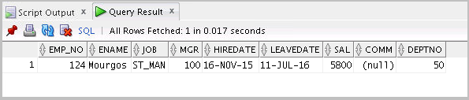
Updating a Row in a Table by Using a Record
DECLARE
v_employee_number number:= 124;
v_emp_rec retired_emps%ROWTYPE;
BEGIN
SELECT * INTO v_emp_rec FROM retired_emps WHERE
empno = v_employee_number;
v_emp_rec.leavedate:= CURRENT_DATE;
UPDATE retired_emps SET ROW = v_emp_rec WHERE
empno=v_employee_number;
END;
/
SELECT * FROM retired_emps;

Slide 18

Agenda
  Understanding composite data types
  Using PL/SQL records
    Manipulating data with PL/SQL records
    Advantages of the %ROWTYPE attribute
  Using PL/SQL collections
    Examining associative arrays
    Introducing nested tables
    Introducing VARRAY

Slide 19
Associative Arrays (INDEX BY Tables)
An associative array is a PL/SQL collection with two columns:
  Primary key of integer or string data type
  Column of scalar or record data type
Key | Value
1 | JONES
2 | HARDEY
3 | MADURO
4 | KRAMER

Slide 20








Generate expense report for each department

Slide 21


Associative Array Structure
2
2
1
Unique key column
…
1
5
3
…
Value
…
Jones
Smith
Maduro
…
Value
… | … | …
110 | ADMIN | Jones
103 | ADMIN | Smith
176 | IT_PROG | Maduro
… | … | …
Value
Unique key column
Unique key column
Unique key column
Unique key column
PLS_INTEGER
SCALAR
RECORD

Slide 22


Steps to Create an Associative Array
Syntax:
  TYPE type_name IS TABLE OF
  { column_type [NOT NULL] | variable%TYPE [NOT NULL]
  | table.column%TYPE [NOT NULL]
  | table%ROWTYPE }
  INDEX BY { PLS_INTEGER | BINARY_INTEGER
  | VARCHAR2(<size>) } ;
  identifier type_name;
Example:
  ...
  TYPE ename_table_type IS TABLE OF
  employees.last_name%TYPE
  INDEX BY PLS_INTEGER;
  ...
  ename_table ename_table_type;

Slide 23

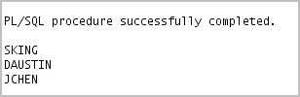
Creating and Accessing Associative Arrays
...
DECLARE
TYPE email_table IS TABLE OF
employees.email%TYPE
INDEX BY PLS_INTEGER;
email_list email_table;
BEGIN
email_list(100) = 'SKING';
email_list(105) = 'DAUSTIN';
email_list(110) = 'JCHEN';
DBMS_OUTPUT.PUT_LINE(email_list(100));
DBMS_OUTPUT.PUT_LINE(email_list(105));
DBMS_OUTPUT.PUT_LINE(email_list(110));
END;
/
...

Slide 24


Associative Arrays with Record values
Define an associative array to hold an entire row from a table.
DECLARE
TYPE dept_table_type
IS
TABLE OF departments%ROWTYPE INDEX BY VARCHAR2(20);
dept_table dept_table_type;
-- Each element of dept_table is a record
BEGIN
SELECT * INTO dept_table(1) FROM departments
WHERE department_id = 10;
DBMS_OUTPUT.PUT_LINE(dept_table(1).department_id ||' '||
dept_table(1).department_name ||' '||
dept_table(1).manager_id);
END;
/

Slide 25

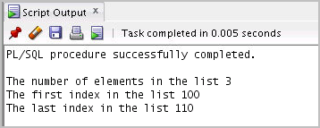
Using Collection Methods
DECLARE
TYPE email_table IS TABLE OF
employees.email%TYPE
INDEX BY PLS_INTEGER;
email_list email_table;
BEGIN
email_list(100) = 'SKING';
email_list(105) = 'DAUSTIN';
email_list(110) = 'JCHEN';
DBMS_OUTPUT.PUT_LINE('The number of elements in the list' || email_list.COUNT);
DBMS_OUTPUT.PUT_LINE('The first index in the list '|| email_list.FIRST);
DBMS_OUTPUT.PUT_LINE('The last index in the list ' || email_list.LAST);
END;
/

Slide 26

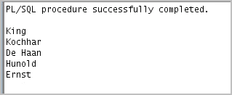
Using Collection Methods with Associative Arrays
DECLARE
TYPE emp_table_type IS TABLE OF
employees%ROWTYPE INDEX BY PLS_INTEGER;
my_emp_table emp_table_type;
max_count NUMBER(3):= 104;
BEGIN
FOR i IN 100..max_count
LOOP
SELECT * INTO my_emp_table(i) FROM employees
WHERE employee_id = i;
END LOOP;
FOR i IN my_emp_table.FIRST..my_emp_table.LAST
LOOP
DBMS_OUTPUT.PUT_LINE(my_emp_table(i).last_name);
END LOOP;
END;
/

Slide 27





Nested Tables
  Nested tables represent sets of values.
  Nested tables can be used as column types in database tables.
  Each entry in the column of the database table can hold a set of values
index | value
1 | SKING
2 | NKOCHAR
3 | LDEHAAN
4 | AHUNOLD

Slide 28


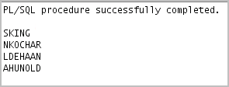
Nested Tables: Syntax and Usage
  Syntax:
  TYPE type_name IS TABLE OF
  {column_type | variable%TYPE
  | table.column%TYPE}[NOT NULL]
  | table.%ROWTYPE
Example:
DECLARE
TYPE dept_mail IS TABLE OF VARCHAR2(20);
mails dept_mail := dept_mail('SKING', 'NKOCHAR', 'LDEHAAN', 'AHUNOLD');
BEGIN
FOR i IN mails.FIRST..mails.LAST LOOP
DBMS_OUTPUT.PUT_LINE(mails(i));
END LOOP;
END;
/

Slide 29

Variable-Sized Arrays (Varrays)
  TYPE emp_mail IS VARRAY(5) OF VARCHAR2(20);
  mails emp_mail;
Declaration
mails(1) | mails(2) | mails(3) | mails(4) | mails(5)
Subscripts to access each varray

Slide 30



VARRAYs: Syntax and Usage
  Syntax:
  TYPE type_name IS VARRAY(SIZE) OF
  {column_type | variable%TYPE
  | table.column%TYPE}[NOT NULL]
  | table.%ROWTYPE
Example:
DECLARE
TYPE emp_mail IS VARRAY(5) OF VARCHAR2(20);
mails emp_mail := emp_mail('NKOCHAR', 'LDEHAAN', 'AHUNOLD');
BEGIN
FOR i IN mails.FIRST..mails.LAST LOOP
DBMS_OUTPUT.PUT_LINE(mails(i));
END LOOP;
END;
/

Slide 31

Summarizing Collections
Associative arrays
  Are key-value pairs
  Are used only in PL/SQL blocks; cannot be persisted to the database
Nested tables
  Are sequentially indexed data
  Can be persisted to the database as columns of a table
Varrays
  Are sequentially indexed data with an upper limit
  Can be persisted to the database as columns of a table

Slide 32

Quiz
Identify situations in which you can use the %ROWTYPE attribute.
  When you are not sure about the structure of the underlying database table
  When you want to retrieve an entire row from a table
  When you want to declare a variable according to another previously declared variable or database column

Slide 33

Summary
In this lesson, you should have learned how to:
  Define and reference PL/SQL variables of composite data types
    PL/SQL record
    Associative array
      INDEX BY table
      INDEX BY table of records
  Define a PL/SQL record by using the %ROWTYPE attribute
  Compare and contrast the three PL/SQL collection types:
    Associative array
    Nested table
    VARRAY

Slide 34


Practice 7: Overview
This practice covers the following topics:
  Declaring associative arrays
  Processing data by using associative arrays
  Declaring a PL/SQL record
  Processing data by using a PL/SQL record

